Slide 1
STORY SHAPE
Plotting a fiction/Story

Slide 2
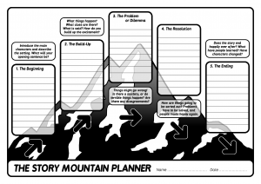
STORY SHAPE TEMPLATE

Slide 3
Elements of a story shape.
The elements of a story shape are:
The Beginning/ introduction- introduces the setting and the character.
The Build ups- when difficult situation/problem arises for the characters.
The Climax- The point where the difficulty or excitement is at the peak.
The Resolution: This is where things get sorted out.
The End/Conclusion: It reveals how the story ended- Comedy/ Tragedy.

Slide 4
ACTIVITY.
Make brief notes about the introduction, build up, climax, resolution and the ending of your own story in the story planner.

